Slide 1

Student Management System
Project By
Cynthia T.M Nyahoda (466762)
Bhupender Bhupender (466758)
Ayyub Orujzade (466757)
University of Warsaw

Slide 2

Objectives:
Make a user-friendly computer system for managing students.
Avoid mistakes by organizing information better.
Create a system that's easy to use for a long time.
Make the system safe and easy to use.
Quickly find and use information.
Help students work together better.
System with Scalability , which can adapt to growing needs of
educational institutions.

Slide 3






Software Requirements:
Frontend: HTML, CSS, JavaScript, Bootstrap
Backend: Python Flask (Python 3.7), SQLAlchemy
Operating System:Windows 10
Web Browsers: Google Chrome/Internet Explorer
Development Tools:
XAMPP (Version-3.7)
PyCharm Community (Python main editor)
Sublime Text 3 (workspace editor)
Hardware Requirements:
Computer with a 1.1 GHz or faster processor
Minimum 2GB of RAM
2.5 GB of available hard-disk space
5400 RPM hard drive
1366 × 768 or higher-resolution display
DVD-ROM drive

Slide 4
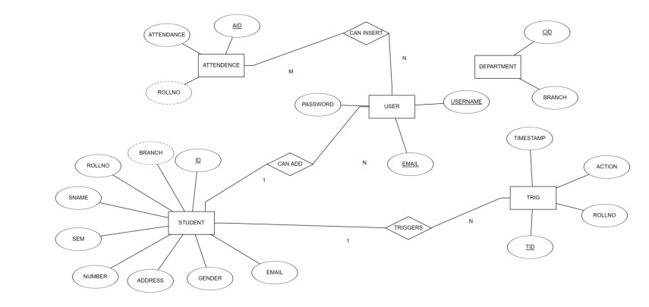
ER - Diagram:

Slide 5

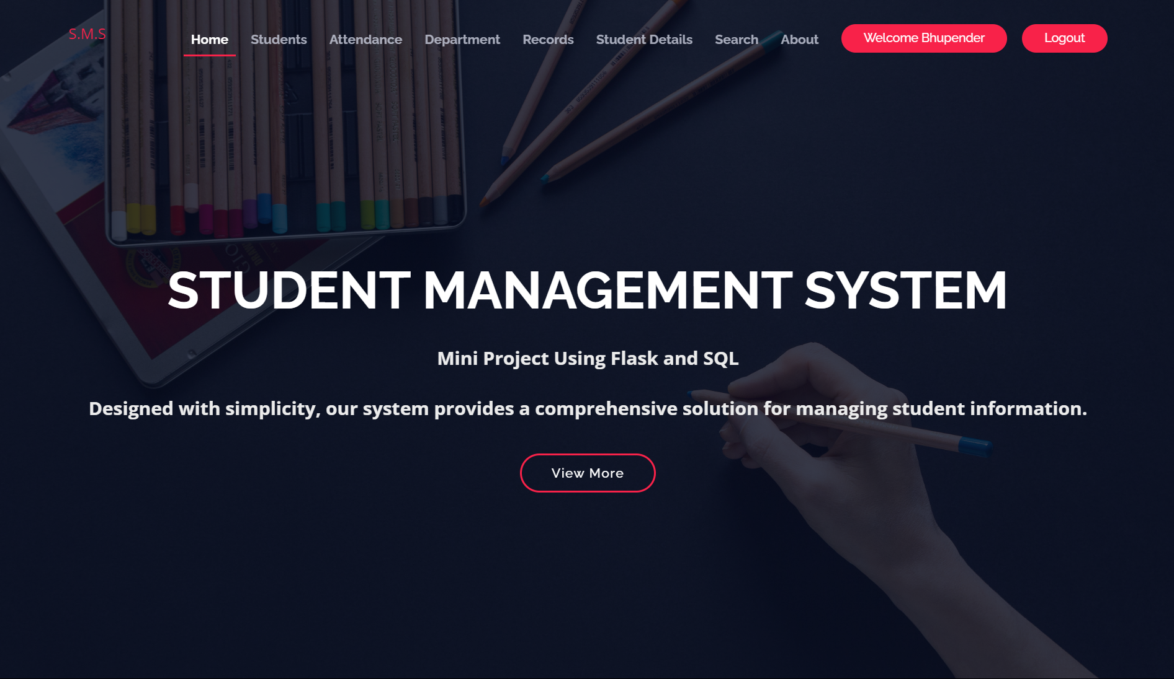
Landing Page:

Slide 6
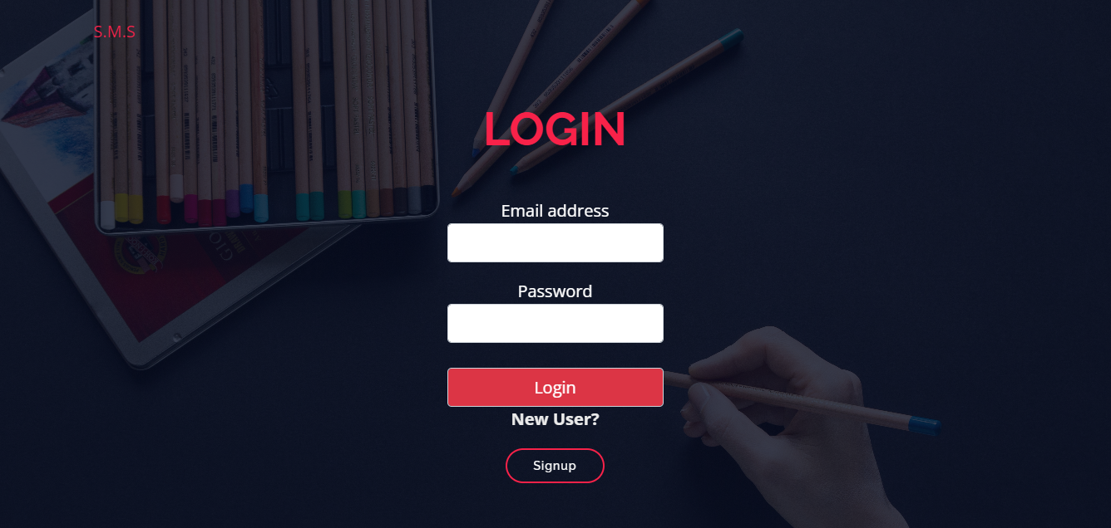
Login Page:

Slide 7
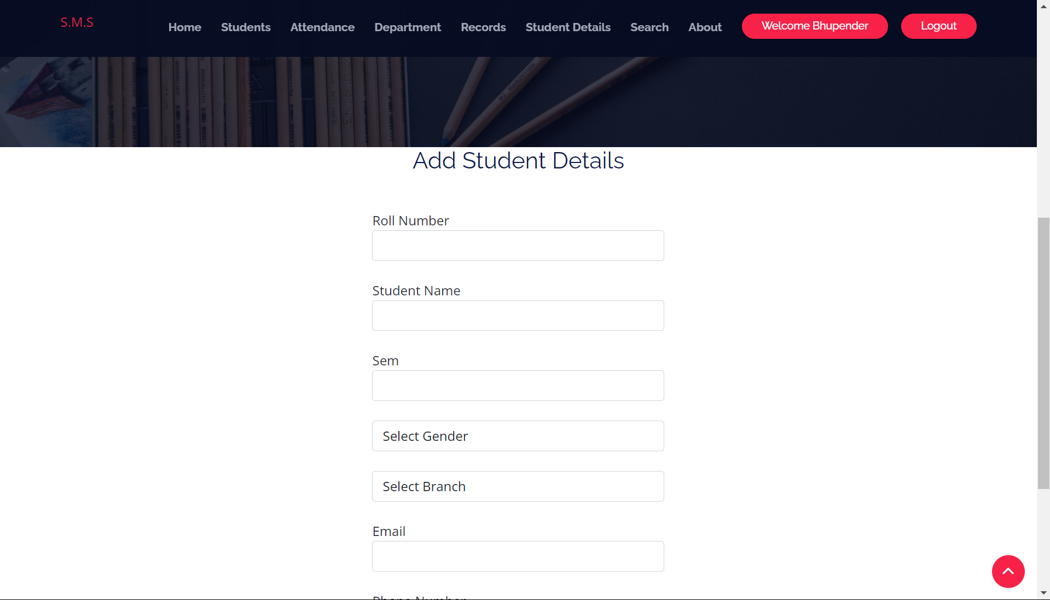
ADD STUDENTS:

Slide 8
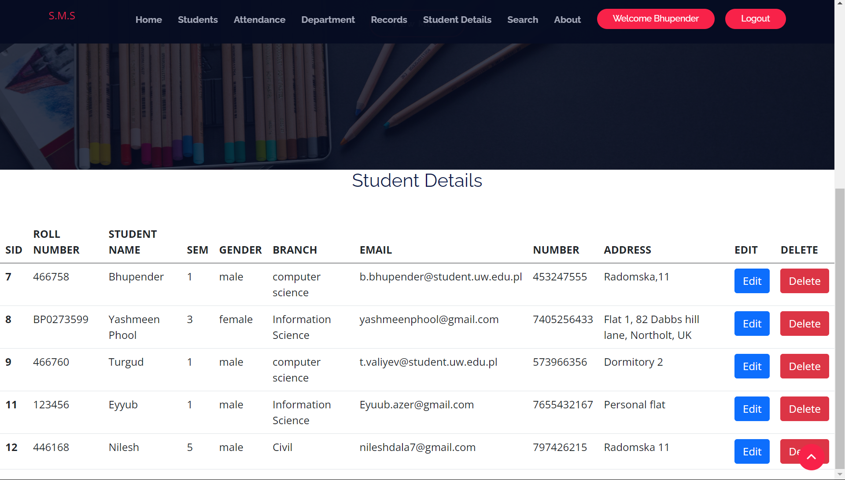
STUDENT Details:

Slide 9
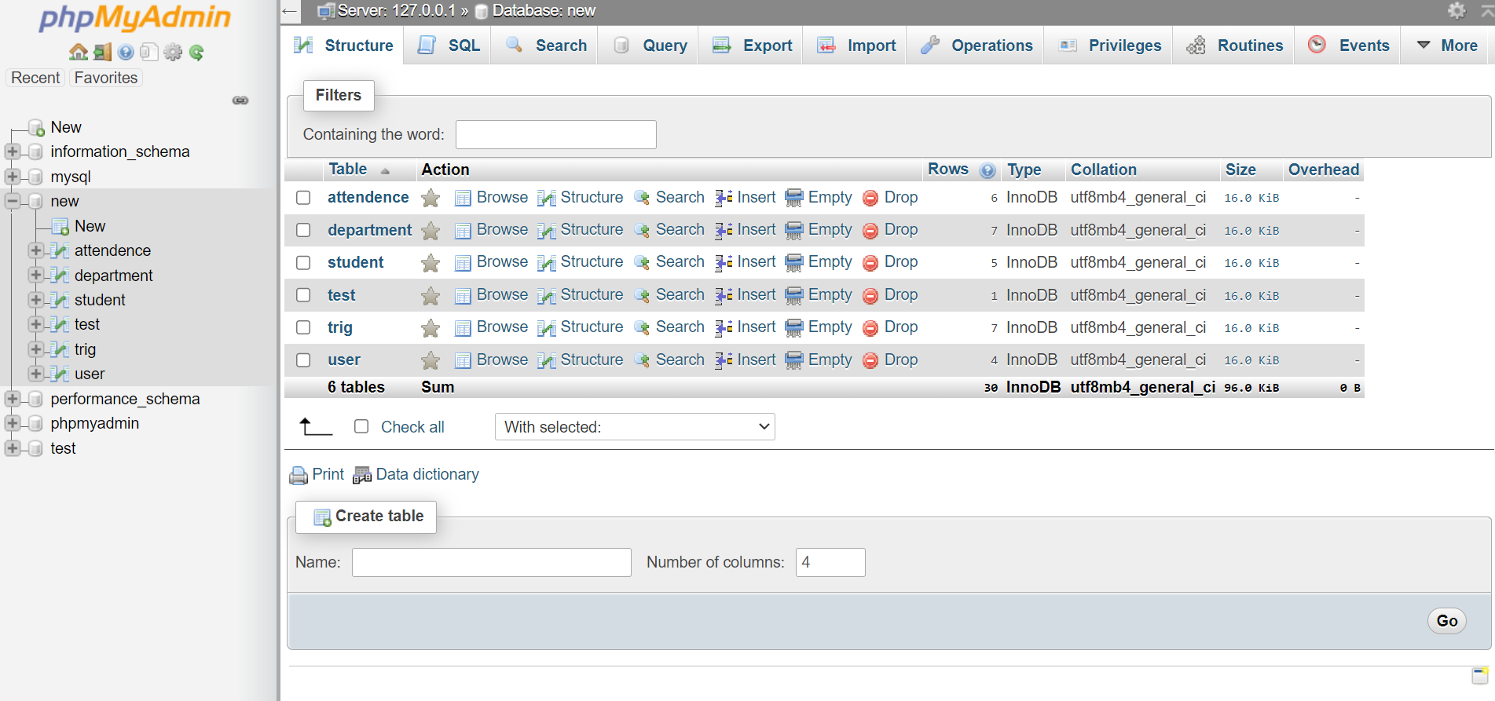
Database:

Slide 10
Instructions: How to Run the Project
Install Required Libraries from Requirements.txt (Using Cmd).
Install Xampp Software using this link: https://www.apachefriends.org/.
Install and Run Xampp -> Run Apache & MySQL. Click on apparent button to MySQL -> Admin to open PhpmyAdmin localhost.
Create a New Database , and import Students.sql file. After importing the database Change the name of database in main.py file In #Change database Section for Users.
Run Python code and click on localhost:http://127.0.0.1:5000/ in terminal section.

